Slide 1
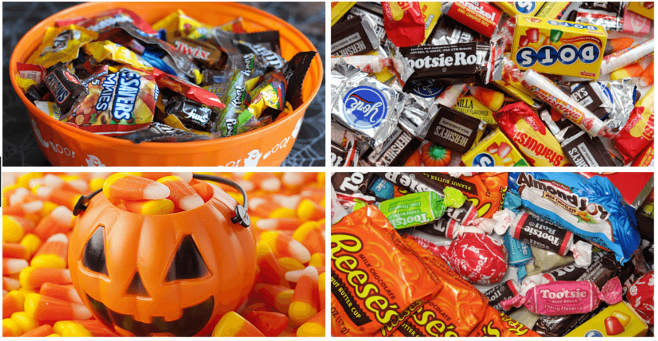

Candy Influencers
ML Algorithm
by Prabhat Verma

Slide 2
Goal
The goal is to predict winpercent (overall win percentage) for a candy in Candy Dataset using appropriate regression models.
Find and Fit an appropriate ML Model

Slide 3
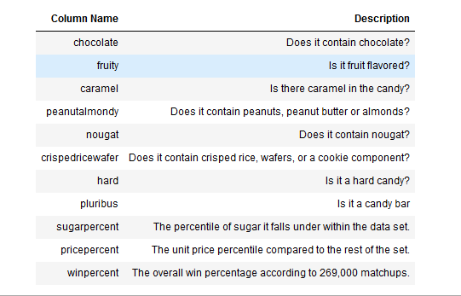
Data Sources
The dataset comprises of 85 observations of 13 columns.

Slide 4
Problem Statement
We want to find a model that given inputs what will be the winpercent ?
Which features contribute the most to winpercent?

Slide 5
Target/Feature Columns
What are the features?
Categorical : chocolate, fruity caramel, peanutyalmondy, nougat, crispedricewafer ,hard ,bar ,pluribus ,sugarpercent , pricepercent
Continous : sugarpercent, pricepercent
What is the response?
Winpercent: The overall win percentage
Output is continuous variable

Slide 6
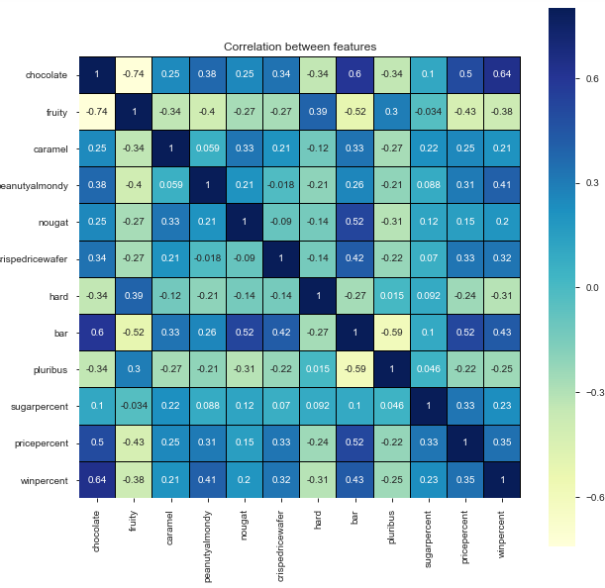
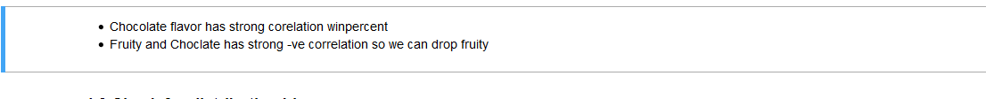
Co-Relation

Slide 7
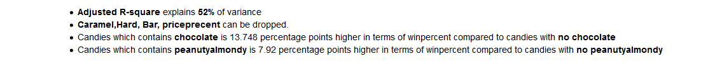
Apply Linear regression
Based on correlation values drop columns 'fruity','nougat','pluribus','sugarpercent','crispedricewafer‘
Train/Test data split is 85-15 percentage
Results

Slide 8
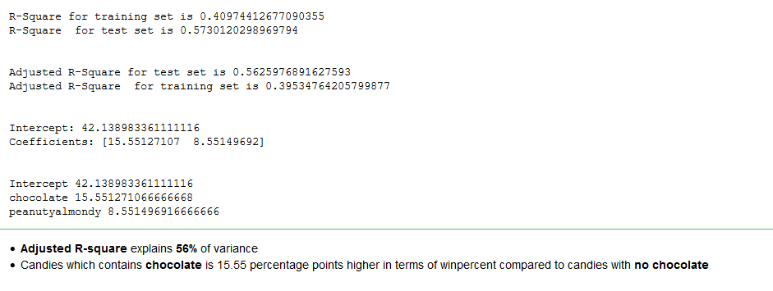
Iter-2
Based on earlier results
Drop 'fruity','nougat','pluribus','sugarpercent','caramel','pricepercent','hard','bar','crispedricewafer''fruity','nougat','pluribus','sugarpercent','crispedricewafer‘
Train/Test data split is 85-15 percentage
Results

Slide 9

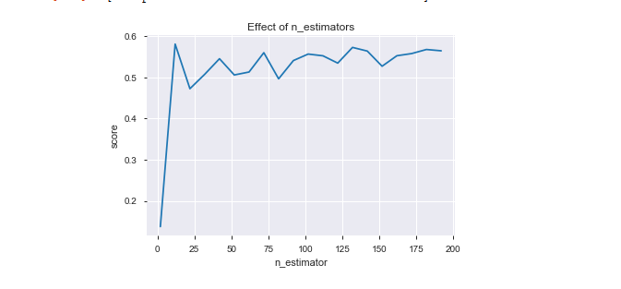
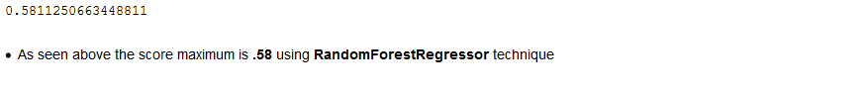
Apply Random Forest Regressor

Slide 10
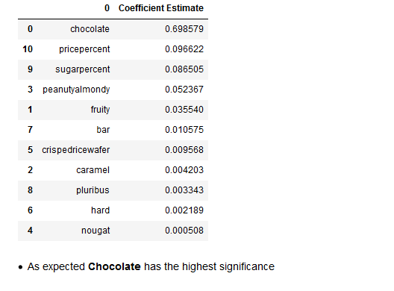
Calculating the magnitude of coefficients

Slide 11
Conclusions
RandomForestRegressor is best model for this dataset.
This model can explain 58.11 percent of variance
Chocolate feature has the highest impact for winning percentage

